Slide 1













Enhancing Underwater Salient Object Detection with the Improved New TC-USOD Model
ALLURI LAKSHMAN NARENDRA-220010002
ATTUNURI Praneeth Reddy -220030005
Kapse Karthik- 220020026

Slide 2

PROBLEM STATMENT
Underwater environments pose challenges for object detection due to light absorption, color distortion, and blurry visuals, affecting marine research on coral reefs and marine animal tracking. Using the USOD10K dataset with preprocessing inspired by "Color Balance and Fusion for Underwater Image Enhancement," we enhanced underwater images by correcting color channels and reducing distortions. This enabled improved detection of marine objects, even in poor lighting and turbid conditions. Our trained model achieved higher accuracy and more visually appealing results compared to existing methods, advancing underwater research and aiding marine exploration and conservation.

Slide 3
DATASET CONSTRUCTION
1) Collection of Images: More than 30,000 candidate underwater images were obtained from multiple sources, such as Google and Bing search engines, other datasets, and field images from studies of underwater engineering in the ocean, lake, and pool scenarios.
2) Image Filtering: A group of five trained volunteers manually filtered the images, removing duplicates and unusable files; 15,000 non-needle images remained for annotation.
3) Image Annotation: Eight professional annotators used pixel-wise tools to label the salient objects in each image. The annotation process was carried out ensuring consistency and correctness by using voting and crosschecking. The quality of annotations is further verified by two other USOD specialist volunteers. Out of this detailed procedure, we harvested 10,255 high-quality annotated images.
4) Dataset Splitting: In order to ensure efficient training and evaluation of the classifier, the dataset was split into training, validation, and test sets in the ratio 7:2:1, respectively. This separation results in uniform data distribution in various categories among the subset

Slide 4
DATASET CHARACTERSTICS
Salient Object Count:
7,832 images with 1 salient object
1,701 images with 2 salient objects
722 images with 3+ salient objects
Supports research on both single and multiple salient object detection.
Object Size:
Sizes range from 0.05% to 93.98% (average: 14.12% of image pixels).
Categories: Large (≥30%): 1,357, Medium (5%–30%): 5,693, Small (≤5%): 3,205 images.
Object Location:
Objects show center bias, concentrated near the image center.
Color Channel Intensity:
Red channel is the weakest due to absorption, with green and blue channels being more prominent.

Slide 5
DATASET CHARACTERSTICS
Additional Features:-
Depth Maps:
Estimated depth maps generated using Dense Prediction Transformer (DPT) for superior accuracy.
Boundary Annotations:
Provides detailed boundary information for all salient objects, aiding boundary-focused model development.

Slide 6
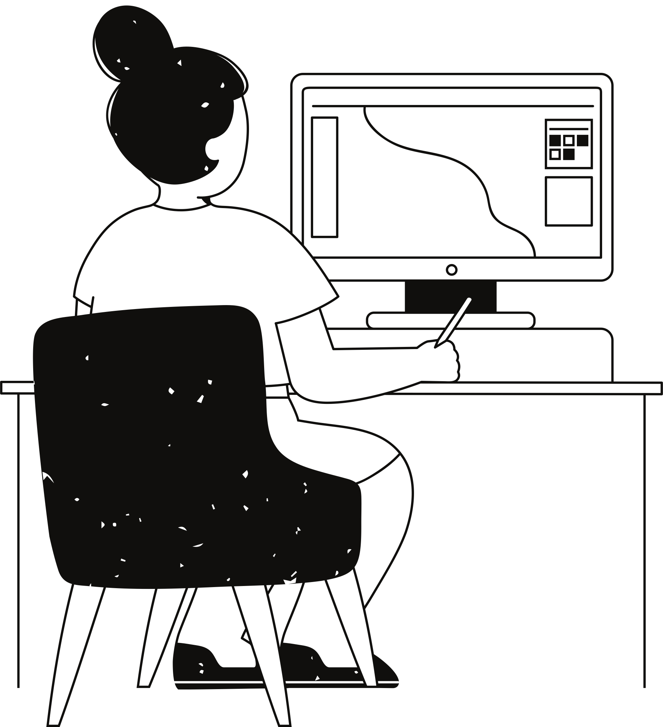
Challenges Observed
Problems we observed: we observed that the outputs have more dominance of red and blue color’s blurred and unclear regions these may affect the detection accuracy
Impact on Outputs: Incorrect detection of salient objects due to color and clarity issues.
.

Slide 7
OUR APPROACH
Our approach addresses the challenges of underwater image degradation caused by light scattering and absorption through an innovative single-image enhancement pipeline. By leveraging a fusion-based strategy, we combine white-balancing techniques tailored to underwater conditions with multiscale fusion for artifact-free image blending. This process enhances edge sharpness, improves global contrast, and restores natural color tones without requiring specialized hardware or prior knowledge of scene structure. The robustness and effectiveness of our solution are validated through qualitative and quantitative assessments, proving its capability to significantly enhance underwater image quality and support downstream tasks such as segmentation and feature matching.

Slide 8
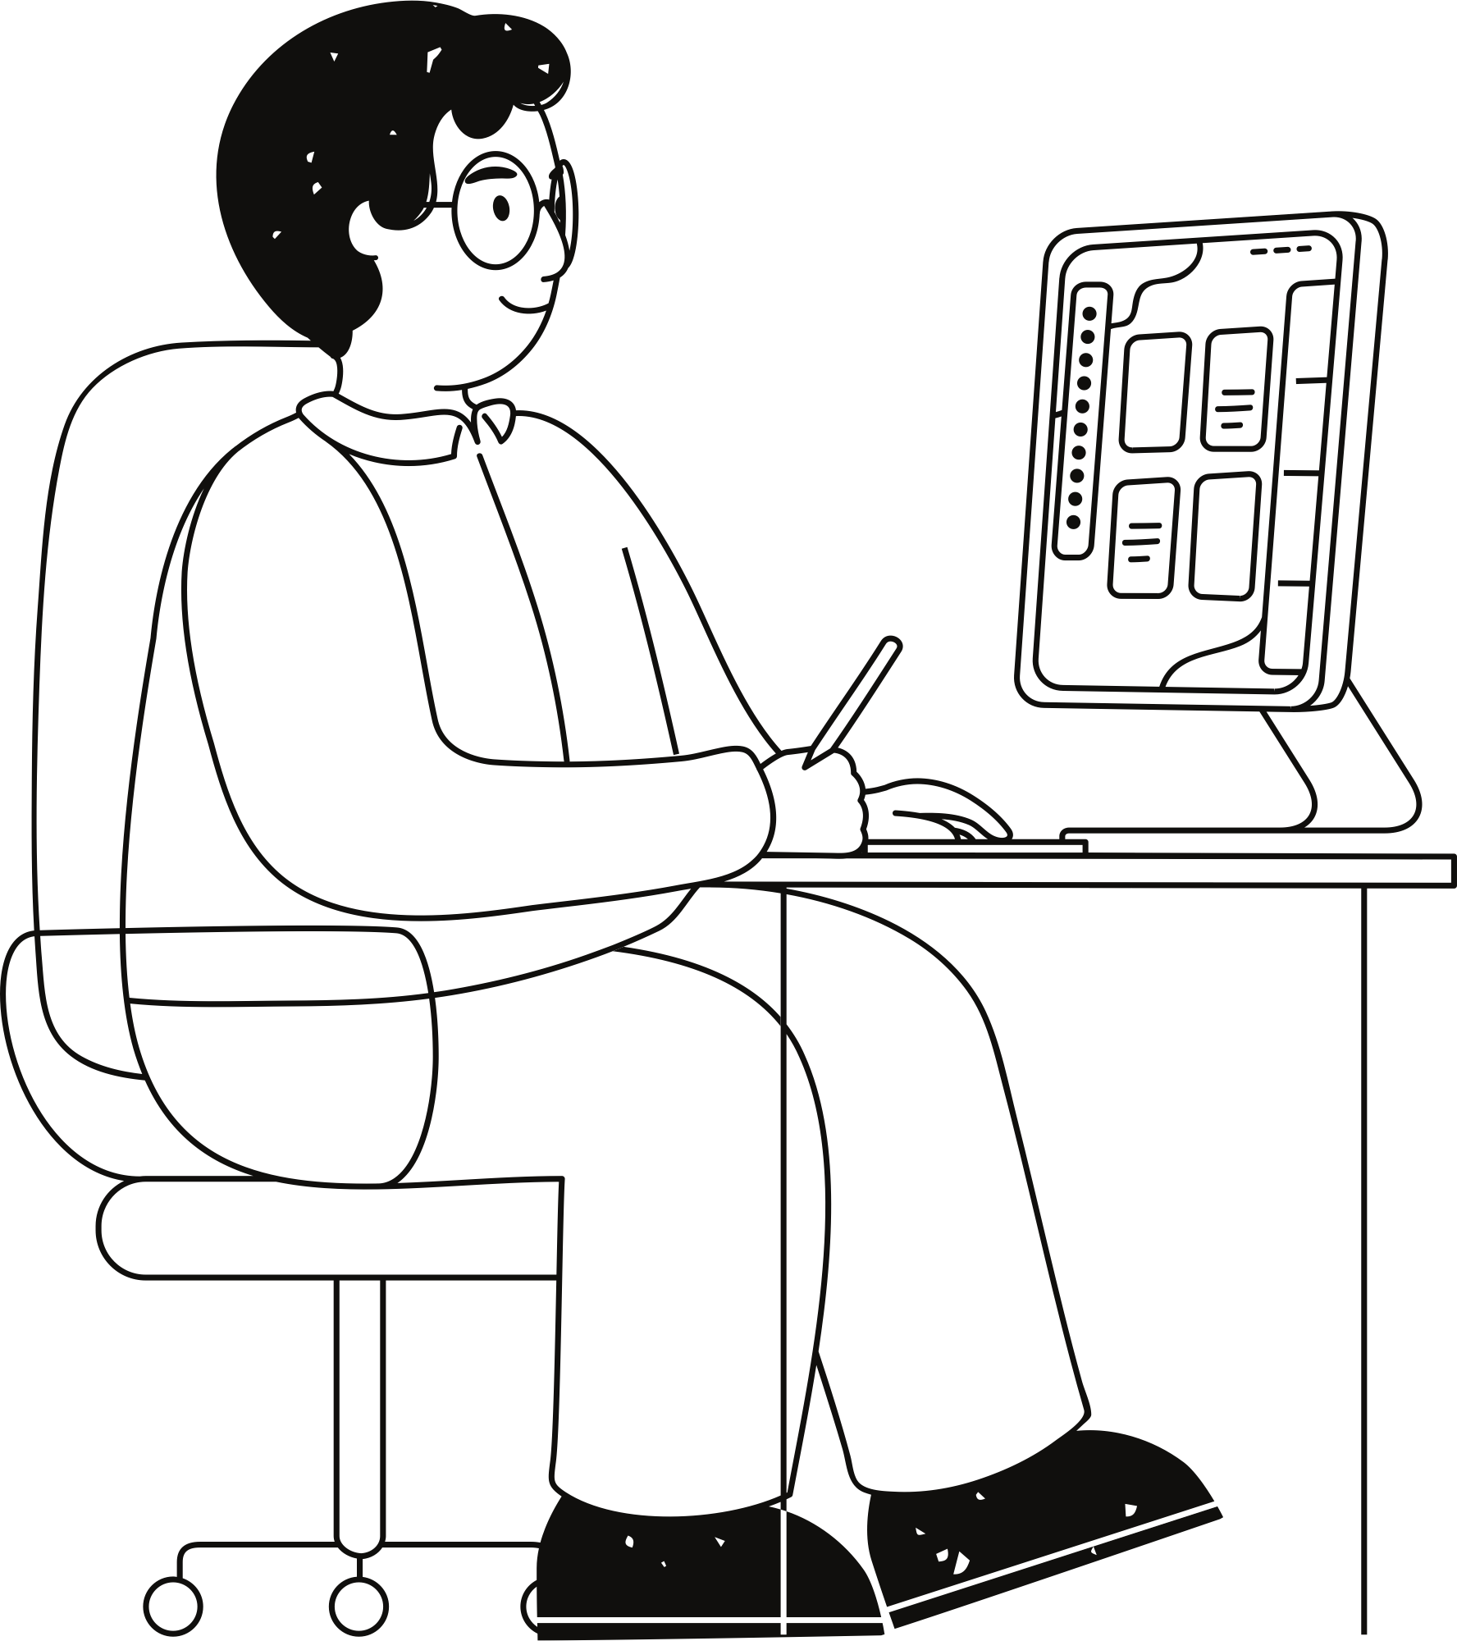
Tackling Colour Distortion and Contrast Issues
Preprocessing: White Balancing and Gamma Correction
White Balancing:
Corrects underwater lighting colour casts to restore natural colours.
Utilizes the Gray World Algorithm:
Adjusts Red, Green, and Blue channels using scaling factors.
Applies scaling to pixel values for each channel.
Gamma Correction:
Enhances visibility and details in darker regions.
γ<1: Brightens the image.
γ>1: Darkens the image.

Slide 9
Enhancing Sharpness and Fusion of Features
Preprocessing: Image Sharpening and Multiscale Fusion
Image Sharpening:
Enhances fine details and edges in underwater images.
Preserves and highlights critical features for accurate analysis.
Multiscale Fusion:
Combines details from sharpened and gamma-corrected images for optimal enhancement.
Integrates features at multiple levels to achieve sharper, high-quality output

Slide 10
Introduction to TC-USOD and Key Modules
Problem Statement:
RGB images lack depth information, making it difficult to detect salient objects in challenging scenarios (e.g., underwater images).
Depth maps provide structural and spatial clues to enhance saliency detection.
Introduction:
TC-USOD is designed to integrate RGB and Depth inputs to improve salient object detection in underwater environments.
Utilizes Cross-Modality Fusion (CMF) and Depth Auxiliary Modules (DAM) for modality interaction.
Proposed Solution:
Depth Auxiliary Module (DAM):
Introduced to encode depth information effectively and integrate it with RGB features.
Combines Channel Attention (CA) and Spatial Attention (SA) to focus on the most relevant features.
Cross-Modality Fusion (CMF):
A combination of channel attention and spatial attention mechanisms to purify and enhance RGB features using depth inputs.
CMF enhances the interaction between RGB and depth streams, ensuring complementary modalities are fused

Slide 11
Encoder Workflow with DAM and CMF
DAM Process:
Takes depth map features from the depth encoder and RGB features from the RGB encoder.
Applies:
Channel Attention: Highlights feature maps most relevant to saliency.
Spatial Attention: Focuses on spatially significant regions.
Outputs fused features, which are added back to RGB features to enhance them.
Encoder Structure:
RGB and depth backbones use T2T-ViT-t-14 as the base architecture.
Features are extracted hierarchically at multiple levels (low-level to high-level semantics).
01.
02.
Soft Splitting in the Encoder:
Depth maps are softly split into hierarchical features at multiple levels:
T1d,T2d,T3dT_1^d, T_2^d, T_3^dT1d​,T2d​,T3d​ represent features extracted at increasing levels of abstraction.
These depth features are fused with RGB features using CMF at each encoder stage.
Key Mechanism:
Multi-level depth-RGB fusion ensures that spatial details (low-level) and semantic details (high-level) are captured effectively.
03.

Slide 12
Connection to Vision Transformer (ViT)
Outputs from Encoder:
RGB encoder outputs F3(high-level RGB features).
Depth encoder outputs F3d(high-level depth features).
Vision Transformer (ViT):
Combines F3and F3d using multi-head self-attention to capture long-range dependencies and modality alignment.
Transformer encodes global relationships between salient regions in RGB and depth maps.
Mechanism of Transformer
Input: extracted Hierarchical feature embeddings from RGB and depth encoders(rgb_vit and dep_vit) through Vit backbone.
Process:
Multi-head self-attention attends to salient regions across RGB and depth modalities.
Embeddings are processed through a series of transformer layers.
Output:
rgb_fea_16: Processed RGB features.
depth_fea_16: Processed depth features.
Spatial resolution: 16×16 times, embedding dimension: 384.

Slide 13
Decoder Workflow Semantic Integration and Up Sampling
Decoder Inputs:
From transformer rgb_fea_16: Processed RGB features and depth_fea_16: Processed depth features.
Intermediate features from the Encoder: F1,F2,F3 and Fd1, Fd2,Fd3​.
Semantic Workflow:
Bridge Layer:
Reduces transformer output dimensions to match encoder feature sizes.
Hierarchical decoding through De Conv layers:
Deconv1 refines features using F3​.
Deconv2 incorporates F2, progressively integrating lower-level spatial details.
Deconv3 and Deconv4 further refine using F1, ensuring high-resolution output.
Multi-Level Feature Fusion:
Combines high-level semantics from the transformer with low-level details from the encoder at each stage.
Achieves a balance between semantic richness and spatial accuracy.
Key Process:
Decoder upsamples the fused features step-by-step to generate high-resolution saliency maps.
Each deconvolution layer refines features further, using skip connections from encoder outputs.
Output:
Saliency map predictions and object boundary maps.

Slide 14
Decoder Workflow Semantic Integration and Up Sampling
Deconv Layers and Multi-Level Feature Fusion
Title: Deconvolution and Multi-Level Feature Fusion in Decoder
Deconv1 to Deconv5:
Deconv1: Upsamples 16×16→32×32 using a 4×4 transposed convolution.
Deconv2: Refines 32×32→64×6432
Deconv3: Refines 64×64→128×128
Deconv4: Refines 128×128→256×256.
Deconv5: Outputs final saliency map (256×256×1) using 3x3convolution.
Activation Function:
ReLU:
Applied after each convolution to introduce non-linearity.
Helps learn complex patterns and prevent gradient vanishing.
Feature Fusion:
At each deconv stage, encoder features (F3,F2,F1F_3, F_2, F_1F3​,F2​,F1​) are fused with upsampled features.
Enhances spatial resolution while retaining semantic information.

Slide 15
Hybrid Loss and Its Effectiveness
Hybrid Loss Definition:
Total loss (ℓ)= ℓ bce+ ℓ iou+ ℓ dice+ ℓ ssim
01
02
03
04
Binary Cross-Entropy (BCE) Loss: Pixel-wise accuracy for saliency prediction.
IoU Loss: Encourages significant overlap between predictions and ground truth.
Dice Loss: Balances precision and recall, effective for class imbalance.
SSIM Loss: Focuses on structural similarity for sharp boundary prediction.
Improvements:
Ablation studies confirm that combining all four losses yields superior performance on the USOD10K dataset.
Hybrid loss ensures:
Accurate binary saliency maps.
Well-defined object boundaries.

Slide 16
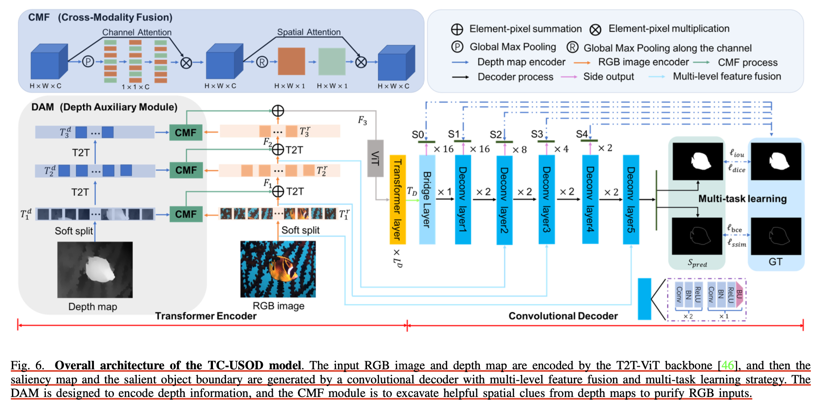
ARCHITECHTURE

Slide 17
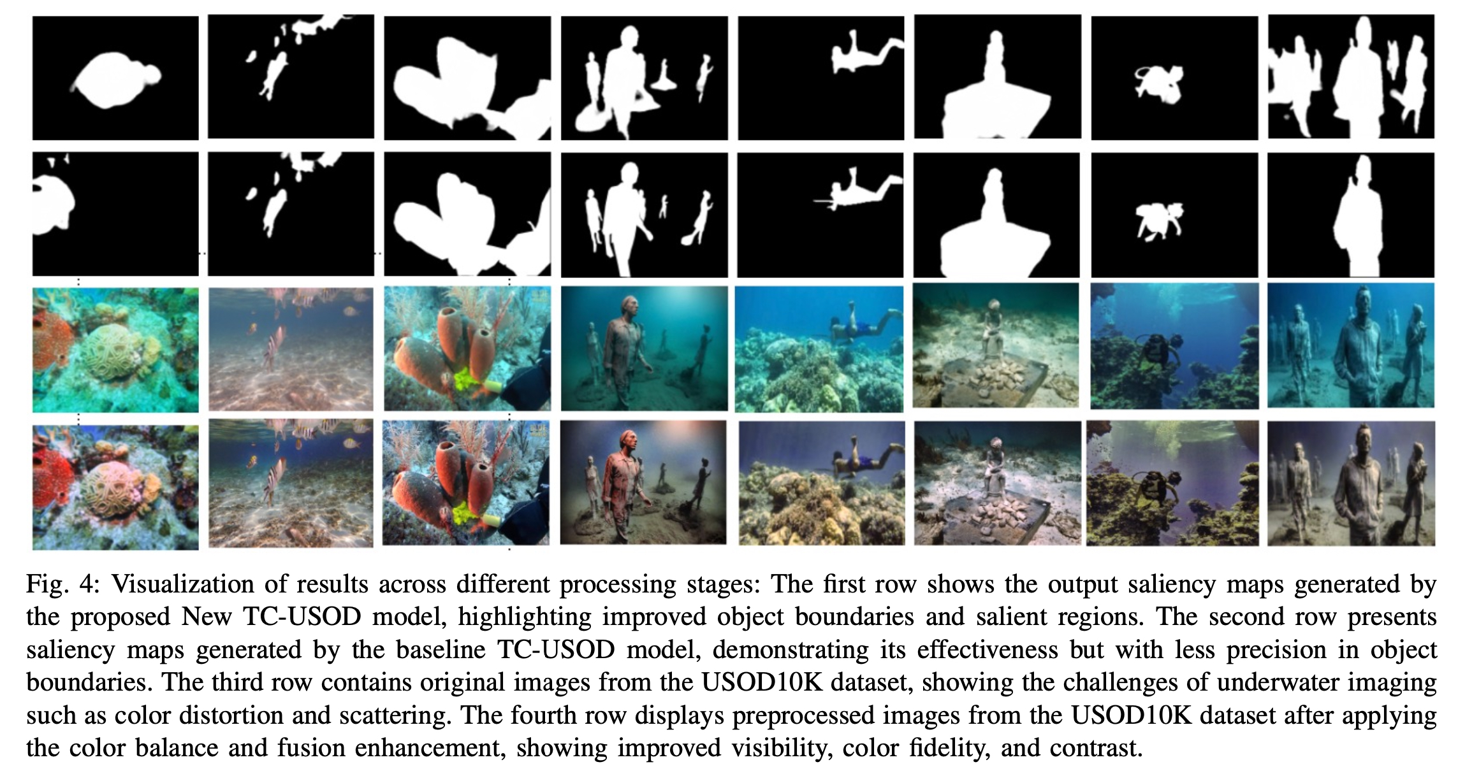
Outputs Observed

Slide 18
Major problem in USOD is nature of Underwater images which are significantly different when compared to terrestrial images.
01.
.
Novelty and achievements
So we applied some changes to underwater dataset and made it look like some terrestrial images with help of colour fusion and balance techniques.
02.
This technique helps in detecting some of the small objects and colours which go unnoticed when we take underwater images.
03.
Changes made to improve the results
04.
With this techniques we have achieved marginal improvements in AUC , AP and Mean Error.

Slide 19
RESULTS
Settings | MEANE | MEANF | AP | MAE | AUC
TC-USOD | 0.9568 | 0.9021 | 0.8953 | 0.0228 | 0.9607
New TC-USOD | 0.9516 | 0.8946 | 0.8963 | 0.0238 | 0.9638
New TC-USOD performed better in terms of Area
Under Curve , Mean Error and Average precision
And the improvements in terms of results can be
Seen in upcoming slides

Slide 20
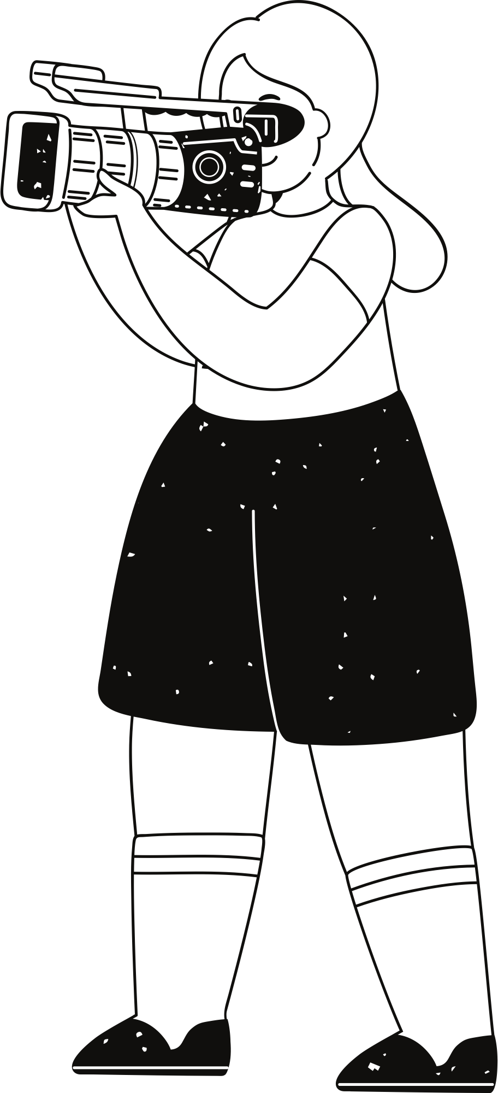
Discussion On Results
E Measure
Average Precision
Lower Emeasure indicates that
New TC-USOD has better
performance in capturing object boundaries when compared to TC-USOD.
.
Higher Average precision indicates that New TC-USOD is better at correctly identifying relevant objects across various threshold values.
.
Area Under Curve
Higher Area Under Curve indicates that new TC-USOD is better at ranking positive than negatives when compared to TC-USOD. So, new TC-USOD has potential to work at different operating points.

Slide 21
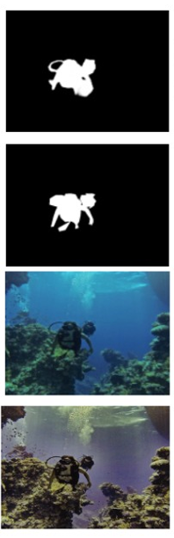
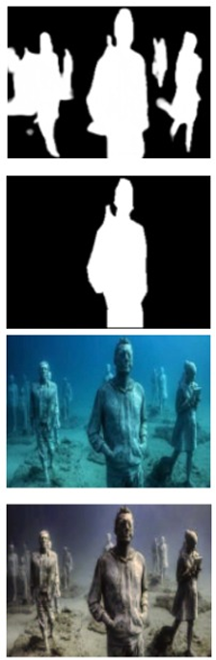
Output from New TC-USOD Model
Output from TC-USOD Model
Image from USOD-10K dataset
Image from the pre-processed dataset

Slide 22

Depth Map Estimation
depth information can be re graded as complementary guidance to address the overlapping and viewpoint issues in SOD. it is impractical to obtain depth information of the observed underwater scene by using sensors that commonly used in the terrestrial field.
Mutual transfer between SOD and USOD methods
It is labor-costs and time-consuming to retrain models related to SOD and USOD. Thus we need to consider techniques through which we can transform the knowledge in between different SOD and USOD models.
,.
Future
Scope
.
Exploring USOD
Real-time USOD Inference
existing deep learning-based USOD methods cannot perform real time interference since they relay on high amount of computations.So it is difficult in case of robots moving under water to be autonomous.We can work and try to improve this.
Weakly/Self/Un-Supervised Learning
SOD methods relies on the availability of large-scale pixel-wise annotated datasets.making pixel wise annotations for training datasets is labor-intensive and time-consuming. This problem can be solved by using Weakly/Un-Supervised Learning.

Slide 23
CONCLUSIONS
TC-USOD, a hybrid model using a transformer encoder and convolutional decoder, introduces the DAM module, multi-task learning, and feature fusion to generate accurate saliency maps.
The enhanced New TC-USOD model shows improvements in Average Precision (AP) and Area Under Curve (AUC), excelling in distinguishing salient regions despite a marginally lower E-measure.
Advanced physics techniques can further enhance underwater images by reducing scattering and absorption, fostering interdisciplinary research and propelling underwater salient object detection (USOD) advancements.

Slide 24

CONTRIBUTIONS
Lakshman:
Identified the core challenges in underwater salient object detection (USOD), such as light absorption, scattering effects, and colour distortion in underwater images.
Researched and implemented the colour balance and fusion techniques for underwater image enhancement.
Focused on improving image quality by removing the effects of blue light and mitigating underwater scattering effects.
Praneeth:
Enhanced the USOD-10K dataset by applying Lakshman's colour balance and fusion techniques to underwater images.
Trained the base TC-USOD model on the enhanced dataset and validated its performance.
Conducted comparative analysis between the base TC-USOD and the enhanced TC-USOD models.
Highlighted improvements in salient object boundary detection with the enhanced model
Karthik:
Performed detailed evaluation of the error metrics, comparing the performance of both models.
Analyzed improvements in key metrics such as E-measure, Average Precision (AP), and Area Under the Curve (AUC) (referenced in Table above).

Slide 25
Thank you

